Slide 1


Slide 2
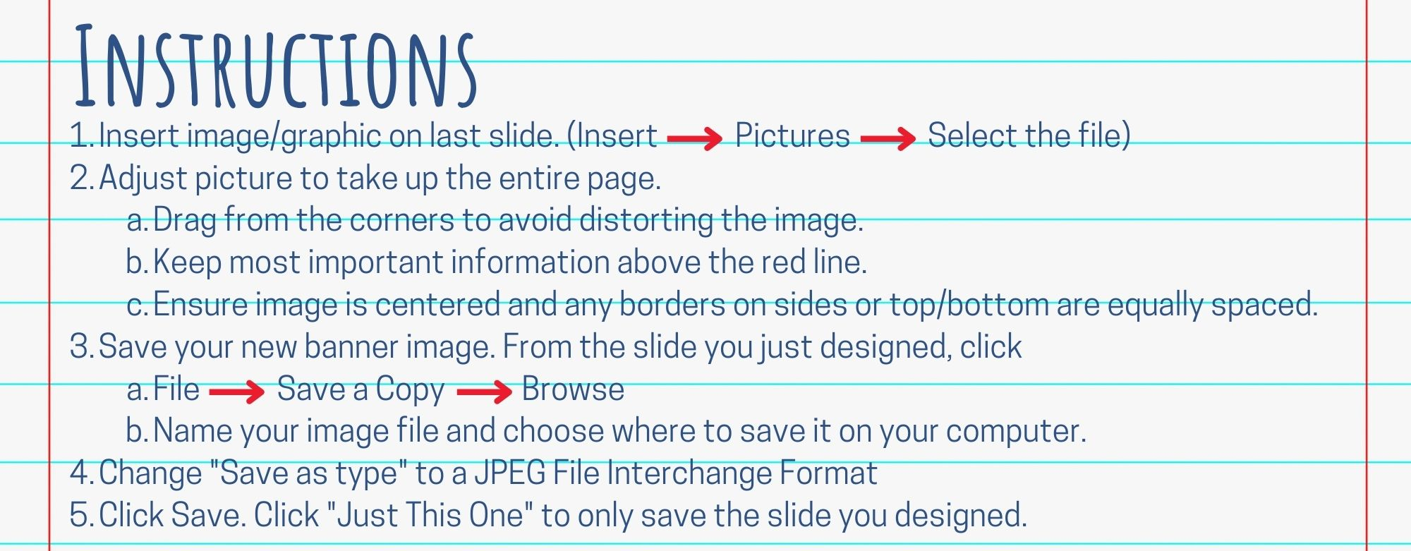

Slide 3
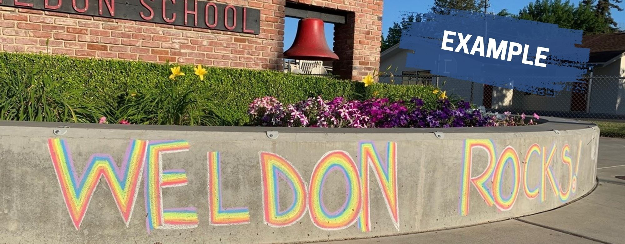

Slide 4
Image should fill entire slide.
Keep most important information above red line, as image gradually grays out toward bottom.
Delete the red line and text when designing your banner.

Slide 5
